Slide 1
Customer Lifetime Value Part II non-contractual settings
Customer Analytics
Lecture 7

Slide 2
Agenda
Non-contractual settings
Concept: latent attrition
BG/BB model
Other latent attrition models (Pareto/NBD model, BG/NBD)

Slide 3
Review:
Netflix said it added 7.05 million subscribers during the fiscal 4th quarter. For the quarter, Netflix added 1.93 million memberships in the U.S. and 5.12 million internationally.
Bol.com opened its doors on 30 March 1999. Eighteen years later, the store has more than 7 million active customers* in the Netherlands and Belgium and an assortment of almost 15 million items.
* customers are considered active when they have placed an order during the preceding twelve-month period
Netflix
Bol
How would these numbers change if the threshold were 24 months instead of 12? Or 6 months?
What’s the right number of active customers?

Slide 4
Review
Contractual settings
Non-contractual (a.k.a. transactional) settings
Minority of companies, but growing
Customers notify the company to quit (ending contract)
Any subscription business model: gym membership, internet/cable, bank, insurance
Focus is on retention rate, because quitting is observed.
Majority of companies
Customers silently leave
Grocery store, retailers, fast moving consumer goods (FMCG), hotels, airlines, media
Focus is on repeat purchasing
Last class
This class

Slide 5
Repeat sales for a cohort of customers
# of repeat transactions
0 (first purchase)
Time since first purchase
This is purchasing for an unchanging cohort of customers who started at the same time (year 0)

Slide 6
Declining cohort level repeat purchasing

Slide 7
Latent (unobserved) attrition models
Buy Til You Die
The customer's relationship with a firm has two phases: he is alive for some period of time, then becomes permanently inactive (dead)
Which customers remain alive until the end of the period?
There are several models that fall under the “latent attrition” umbrella, but they all share this idea:
Aggregate repeat transactions
# of repeat transactions
Cust A
Cust B
Cust C
Cust D
0 (first purchase)
Time since first purchase
Notes:
A customer is alive for a period of time, then becomes permanently inactive
By the end of the period, customers A, C & D “die”, B “lives”
“Buy til you die”
The sum of the transactions is the sum of the purchases of alive customers
Time at which customer leaves is not observed, but inferred from purchasing data. (dotted lines)

Slide 8
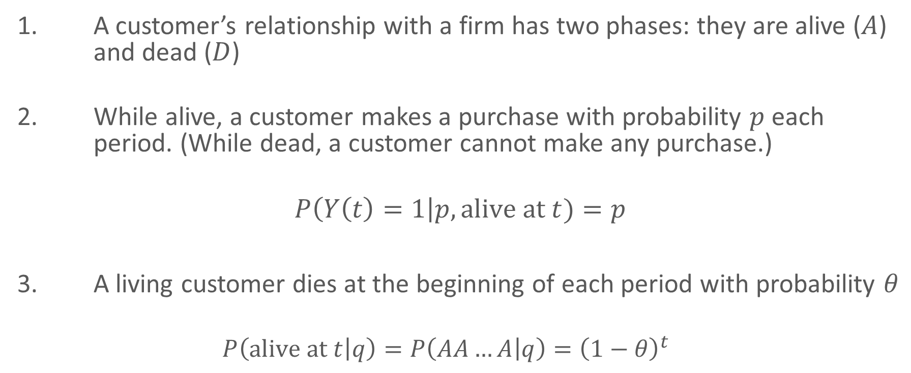
Model development (in discrete time)
1. A customer’s relationship with a firm has two phases: they are alive ($A$) and dead ($D$)
While alive, a customer makes a purchase with probability $p$ each period. (While dead, a customer cannot make any purchase.)
$$P\left(Y\left(t\right)=1\right|p, \text{alive} \text{at} t)=p$$
A living customer dies at the beginning of each period with probability $θ$
$$P\left(\text{alive} \text{at} t | q\right)=P\left(AA…A | q\right)={\left(1−θ\right)}^{t}$$
Fader, Hardie and Shang (2010), Customer-Base Analysis in a Discrete Time Noncontractual Setting
Notes:
Binomial
Geometric: “t” A’s
Note difference with sBG: can be alive but not purchase

Slide 9

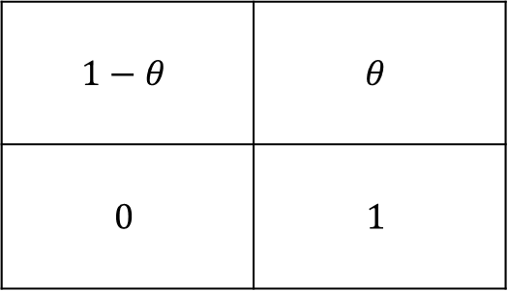




Latent attrition as a hidden Markov model
Unobserved
Transition matrix
Customer state at t
$$1−θ$$
$$1$$
$$θ$$
Alive
Dead
$$1−θ$$ | $$θ$$
$$0$$ | $$1$$
Alive
Dead
Alive
Customer state at t-1
Dead
Death is an absorbing state: no transitions back to Alive.
P(purchase)
$$p$$
$$0$$
Observed
Notes:
The customer may purchase when alive, but not while dead.
Purchasing indicates customer is alive
Not purchasing can mean alive or dead

Slide 10
Since we don’t observe death, how do we infer it?
We use probability to describe the uncertainty about whether a customer is gone temporarily or forever
1 | 2 | 3 | 4 | 5 | 6
1 | 0 | 1 | 1 | 0 | 0
Notes:
D D
D A
A A

Slide 11
Sample history
We use probability to describe the uncertainty about whether a customer is gone temporarily or forever
1 | 2 | 3 | 4 | 5 | 6
1 | 0 | 1 | 1 | 0 | 0
 | A | A | A | A | D | D
 | A | A | A | A | A | D
 | A | A | A | A | A | A

Slide 12
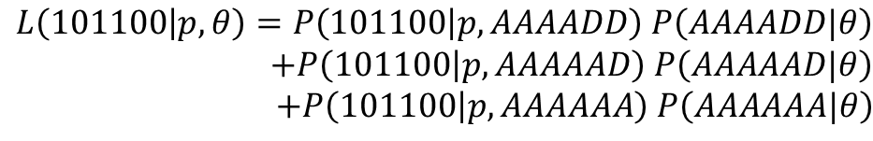
Sample history
We use probability to describe the uncertainty about whether a customer is gone temporarily or forever
1 | 2 | 3 | 4 | 5 | 6
1 | 0 | 1 | 1 | 0 | 0
 | A | A | A | A | D | D
 | A | A | A | A | A | D
 | A | A | A | A | A | A
$$L\left(101100 | p,θ\right)=P\left(101100 | p,AAAADD\right) P\left(AAAADD|θ\right)$$
$$+P\left(101100 | p,AAAAAD\right) P\left(AAAAAD|θ\right) \\ +P\left(101100 | p,AAAAAA\right) P\left(AAAAAA|θ\right)$$

Slide 13
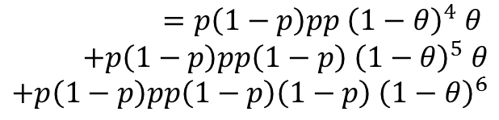
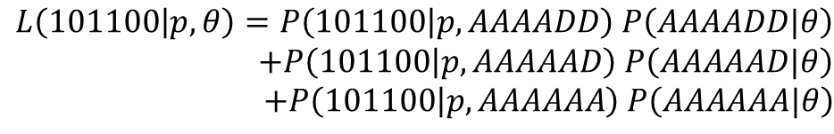
Sample history
We use probability to describe the uncertainty about whether a customer is gone temporarily or forever
1 | 2 | 3 | 4 | 5 | 6
1 | 0 | 1 | 1 | 0 | 0
$$=p\left(1−p\right)pp{ \left(1−θ\right)}^{4} θ \\ +p\left(1−p\right)pp\left(1−p\right) {\left(1−θ\right)}^{5} θ \\ +p\left(1−p\right)pp\left(1−p\right)\left(1−p\right) {\left(1−θ\right)}^{6}$$
 | A | A | A | A | D | D
 | A | A | A | A | A | D
 | A | A | A | A | A | A
$$L\left(101100 | p,θ\right)=P\left(101100 | p,AAAADD\right) P\left(AAAADD|θ\right)$$
$$+P\left(101100 | p,AAAAAD\right) P\left(AAAAAD|θ\right) \\ +P\left(101100 | p,AAAAAA\right) P\left(AAAAAA|θ\right)$$

Slide 14
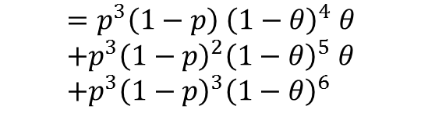
Sample history
We use probability to describe the uncertainty about whether a customer is gone temporarily or forever
1 | 2 | 3 | 4 | 5 | 6
1 | 0 | 1 | 1 | 0 | 0
$$=p\left(1−p\right)pp{ \left(1−θ\right)}^{4} θ \\ +p\left(1−p\right)pp\left(1−p\right) {\left(1−θ\right)}^{5} θ \\ +p\left(1−p\right)pp\left(1−p\right)\left(1−p\right) {\left(1−θ\right)}^{6}$$
 | A | A | A | A | D | D
 | A | A | A | A | A | D
 | A | A | A | A | A | A
$$=p^{3}\left(1−p\right){ \left(1−θ\right)}^{4} θ \\ +p^{3}{\left(1−p\right)}^{2}{\left(1−θ\right)}^{5} θ \\ +p^{3}{\left(1−p\right)}^{3}{\left(1−θ\right)}^{6}$$
$$L\left(101100 | p,θ\right)=P\left(101100 | p,AAAADD\right) P\left(AAAADD|θ\right)$$
$$+P\left(101100 | p,AAAAAD\right) P\left(AAAAAD|θ\right) \\ +P\left(101100 | p,AAAAAA\right) P\left(AAAAAA|θ\right)$$

Slide 15
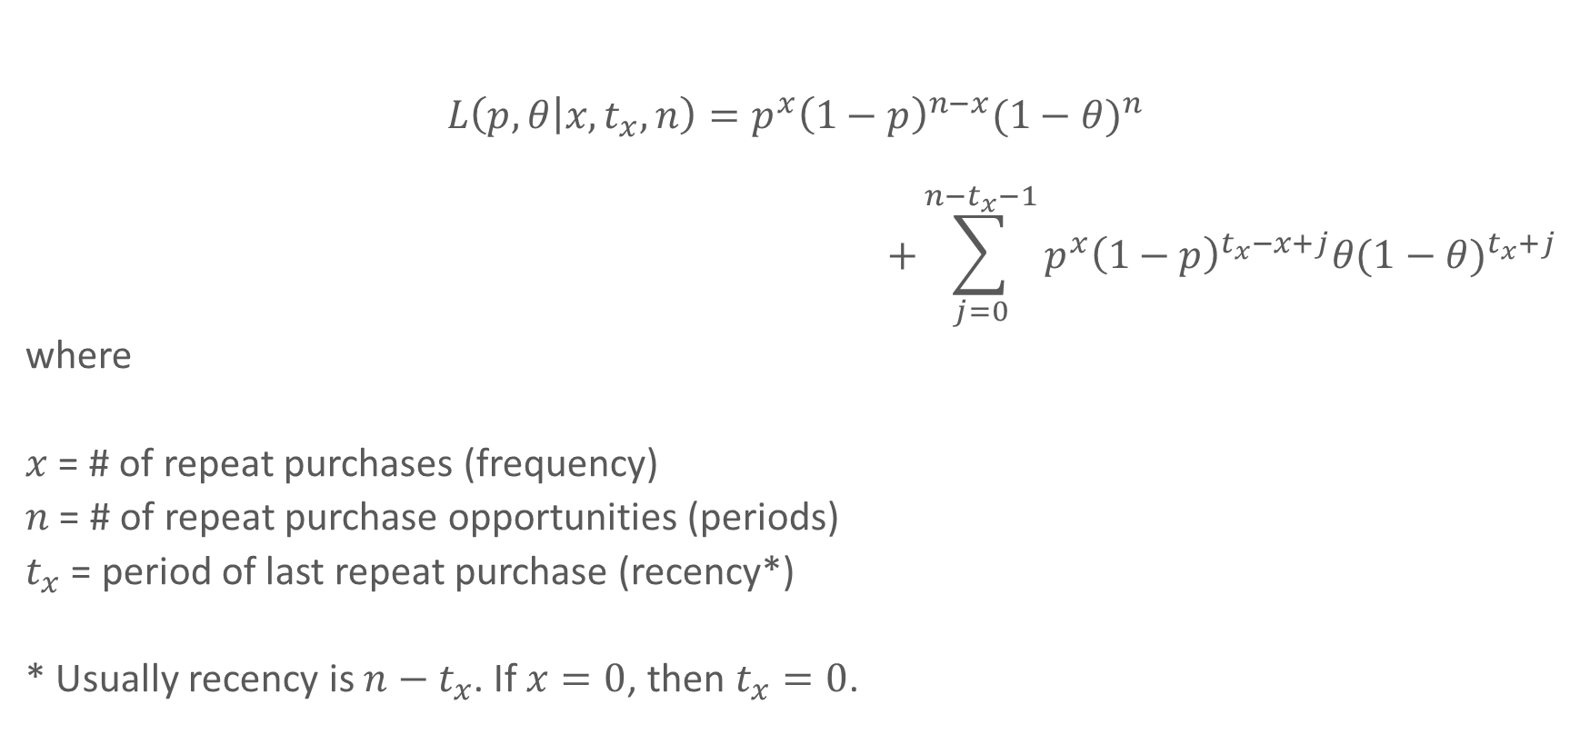
BG/BB Model: individual level likelihood
$$L\left(p,θ\left|x,t_{x},n\right.\right)=p^{x}{\left(1−p\right)}^{n−x}{(1−θ)}^{n}$$
$$+\sum_{j=0}^{n−t_{x}−1}{p^{x}{\left(1−p\right)}^{t_{x}−x+j}θ{(1−θ)}^{t_{x}+j} }$$
where
$x$ = # of repeat purchases (frequency)
$n$ = # of repeat purchase opportunities (periods)
$t_{x}$ = period of last repeat purchase (recency*)
* Usually recency is $n−t_{x}$. If $x=0$, then $t_{x}=0$.
Fader, Hardie and Shang (2010), Customer-Base Analysis in a Discrete Time Noncontractual Setting
Notes:
Top: alive until the end
Sum terms: all possible points that could die.
What are n, t and x in the last example?

Slide 16
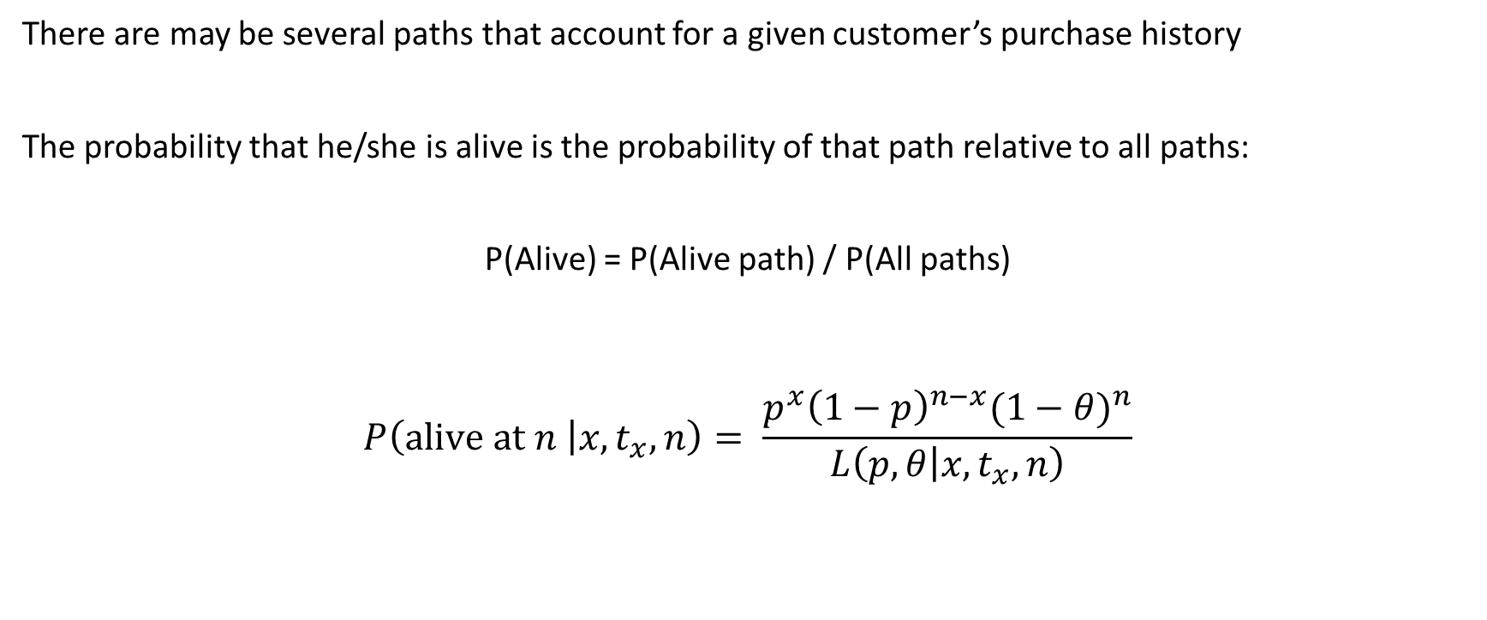
P(Alive)
There are may be several paths that account for a given customer’s purchase history
The probability that he/she is alive is the probability of that path relative to all paths:
P(Alive) = P(Alive path) / P(All paths)
$$P\left(\text{alive} \text{at} n \left|x,t_{x},n\right.\right)= \frac{p^{x}{\left(1−p\right)}^{n−x}{(1−θ)}^{n}}{L\left(p,θ\left|x,t_{x},n\right.\right)}$$
Notes:
L is from last slide

Slide 17
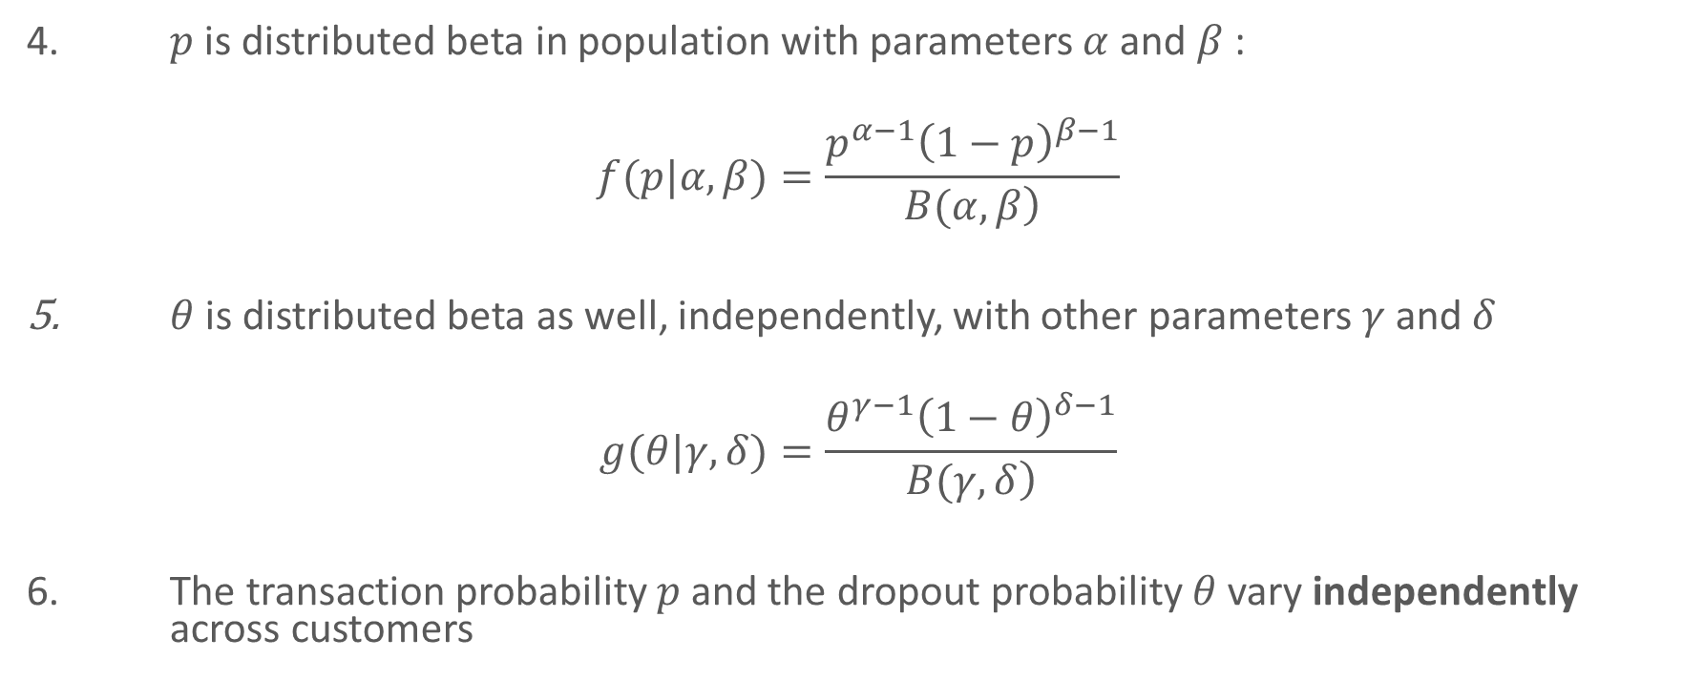
Model development (heterogeneity)
4. $p$ is distributed beta in population with parameters $α$ and $β$:
$$f(p|α,β)=\frac{p^{α−1}{\left(1−p\right)}^{β−1}}{\left.B(α,β\right)}$$
$θ$ is distributed beta as well, independently, with other parameters $γ$ and $δ$
$$g(θ|γ,δ)=\frac{θ^{γ−1}{\left(1−θ\right)}^{δ−1}}{\left.B(γ,δ\right)}$$
6. The transaction probability 𝑝 and the dropout probability 𝜃 vary independently across customers
Fader, Hardie and Shang (2010), Customer-Base Analysis in a Discrete Time Noncontractual Setting

Slide 18
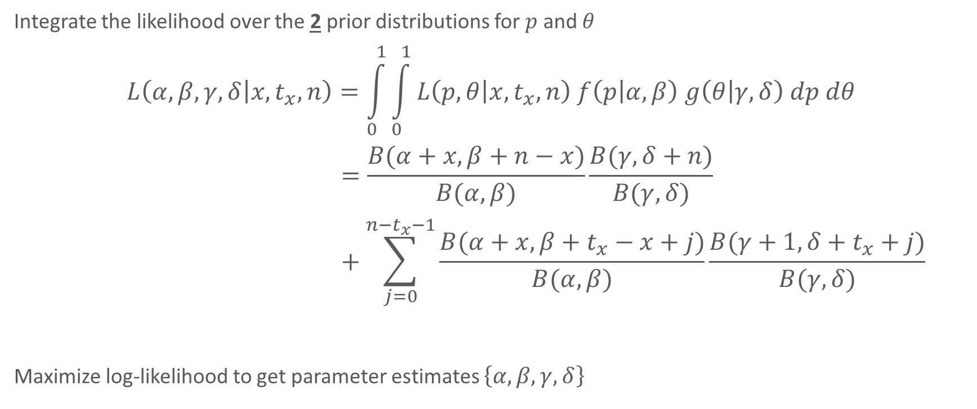
Beta-geometric/Beta-binomial (BGBB) model likelihood
Integrate the likelihood over the 2 prior distributions for $p$ and $θ$
$$L\left(α,β,γ,δ\left|x,t_{x},n\right.\right)=\int_{0}^{1}{\int_{0}^{1}{L\left(p,θ\left|x,t_{x},n\right.\right) f\left(p | α,β\right) g\left(θ | γ,δ\right) dp dθ}}$$
$$=\frac{B(α+x,β+n−x)}{B(α,β)}\frac{B(γ,δ+n)}{B(γ,δ)}+\sum_{j=0}^{n−t_{x}−1}{\frac{B(α+x,β+t_{x}−x+j)}{B(α,β)}\frac{B(γ+1,δ+t_{x}+j)}{B(γ,δ)}}$$
Maximize log-likelihood to get parameter estimates $\left\{α, β, γ, δ\right\}$
Notes:
Top part if alive until the end, sum all possible times that customer can die given history.

Slide 19
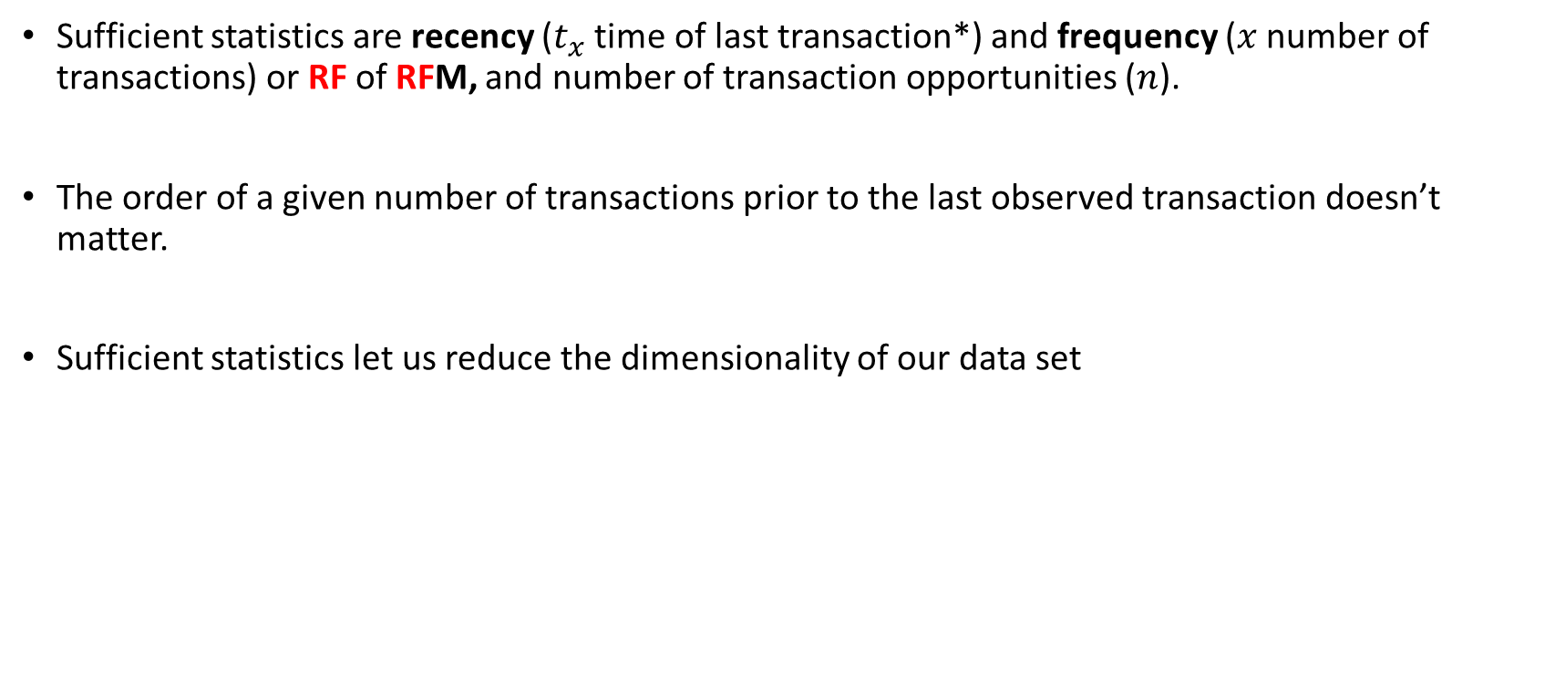
Sufficient statistics
Sufficient statistics are recency ($t_{x}$ time of last transaction*) and frequency ($x$ number of transactions) or RF of RFM, and number of transaction opportunities ($n$).
The order of a given number of transactions prior to the last observed transaction doesn’t matter.
Sufficient statistics let us reduce the dimensionality of our data set
* Not exactly as in RFM, as we mentioned in slide 15

Slide 20
An example
First purchase
(all 1’s)
Next six years of
donation data
we use to fit model
Following 5 years: we use to validate model
Donations to a charity, of a group customers who made their first donation in 1995 (n=11104)
Over 1996-2001, cohort makes 24,615 repeat donations.
How many do they make in 2002-2006?

Slide 21
Sufficient statistics
❶
x (frequency) | t_x (recency) | n (years) | # donors
6 | 6 | 6 | 1203
5 | 6 | 6 | 728
4 | 6 | 6 | 512
3 | 6 | 6 | 357
2 | 6 | 6 | 234
1 | 6 | 6 | 129
5 | 5 | 6 | 335
4 | 5 | 6 | 284
3 | 5 | 6 | 225
2 | 5 | 6 | 173
1 | 5 | 6 | 119
4 | 4 | 6 | 240
3 | 4 | 6 | 181
2 | 4 | 6 | 155
1 | 4 | 6 | 78
3 | 3 | 6 | 322
2 | 3 | 6 | 255
1 | 3 | 6 | 129
2 | 2 | 6 | 613
1 | 2 | 6 | 277
1 | 1 | 6 | 1091
0 | 0 | 6 | 3464
 | 1996 | 1997 | 1998 | 1999 | 2000 | 2001
❶ | 1 | 1 | 1 | 1 | 1 | 1
❷ | 0 | 0 | 0 | 0 | 0 | 0
❸ | 0 | 0 | 0 | 0 | 1 | 1
❸ | 1 | 0 | 0 | 0 | 0 | 1
❸
{x, t_{x}, n}
❶ = {6, 6, 6}
❷ = {0, 0, 6}
❸ = {2, 6, 6}
❷
Likelihood

Slide 22




Distribution of transaction and dropout probabilities in the customer base
$$α=1.204, β=0.750$$
$$γ=0.657, δ=2.783$$
$$E\left[p\right]=\frac{α}{α+β}=0.616$$
$$E\left[θ\right]=\frac{γ}{γ+δ}=0.191$$

Slide 23
Aggregate forecasting
How many do they make in 2002-2006?
We can expect 13000 donations 2002-2006

Slide 24
Model predictions: Predictions by both R & F
Using the model, expected number of transactions in the next 5 periods, conditional on R and F
=== ==== ==== ==== ==== ==== ==== ====
\ 0 1 2 3 4 5 6
=== ==== ==== ==== ==== ==== ==== ====
6 0.00 0.00 0.00 0.00 0.00 0.00 3.75
5 0.00 0.00 0.00 0.00 0.00 1.81 3.23
4 0.00 0.00 0.00 0.00 0.58 2.03 2.71
3 0.00 0.00 0.00 0.22 1.03 1.80 2.19
2 0.00 0.00 0.12 0.54 1.06 1.44 1.67
1 0.00 0.09 0.31 0.59 0.84 1.02 1.15
0 0.07 0.00 0.00 0.00 0.00 0.00 0.00
=== ==== ==== ==== ==== ==== ==== ====

Slide 25
Model fit: Predictions by F groups
If we’re interested in RLV, we should care about more individual level predictions: how many transactions from a customer with “6 for 6” do we predict? How close are we to the actual?
Notes:
## freq.0 freq.1 freq.2 freq.3 freq.4 freq.5 freq.6
## act 0.1744 0.433 0.813 1.39 2.06 2.64 3.53
## exp 0.0729 0.325 0.709 1.33 2.03 2.78 3.75
## bin 3464.0000 1823.000 1430.000 1085.00 1036.00 1063.00 1203.00

Slide 26
Model fit: Predictions by R groups
Same idea, but for recency: how much do we predict for a recent vs. not recent customer? How close is it to the truth?
Notes:
## rec.0 rec.1 rec.2 rec.3 rec.4 rec.5 rec.6
## act 0.1744 0.2181 0.39 0.487 0.809 1.65 2.95
## exp 0.0729 0.0857 0.18 0.404 0.851 1.73 3.03
## bin 3464.0000 1091.0000 890.00 706.000 654.000 1136.00 3163.00

Slide 27
P(Alive at n+1) by R
The probability that a customer who was “1 for 6” with the single transaction occurring at 1, 2, .. 6 is alive at the next transaction
{x = 1, t_{x} =1, .. ,6, n}
Notes:
# The probability that a customer who made 3 transactions in
# the calibration period (which consisted of 6 transaction
# opportunities), with the last transaction occurring at the
# 4th transaction opportunity, is alive at the 7th transaction
# opportunity
b

Slide 28
P(Alive) by F: increasing frequency paradox
{x = 1,..,4, t_{x} =4 , n}

Slide 29
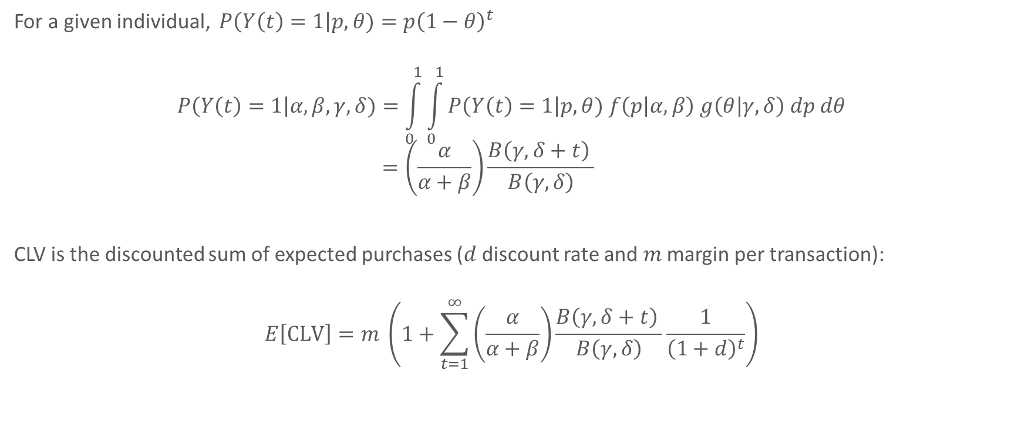
CLV
For a given individual, $P\left(Y\left(t\right)=1\right|p, θ)=p{\left(1−θ\right)}^{t}$
$$P\left(Y\left(t\right)=1\right|α, β, γ,δ)=\int_{0}^{1}{\int_{0}^{1}{P\left(Y\left(t\right)=1\right|p, θ) f\left(p | α,β\right) g\left(θ | γ,δ\right) dp dθ}}$$
$$=\left(\frac{α}{α+β}\right)\frac{B\left(γ, δ+t\right) }{B\left(γ,δ\right)}$$
CLV is the discounted sum of expected purchases ($d$ discount rate and $m$ margin per transaction):
$$E\left[\text{CLV}\right]=m \left(1+\sum_{t=1}^{∞}{\left(\frac{α}{α+β}\right)\frac{B\left(γ, δ+t\right) }{B\left(γ,δ\right)}\frac{1}{{\left(1+d\right)}^{t}}}\right)$$
CLV=185, for m=50, d=.1

Slide 30
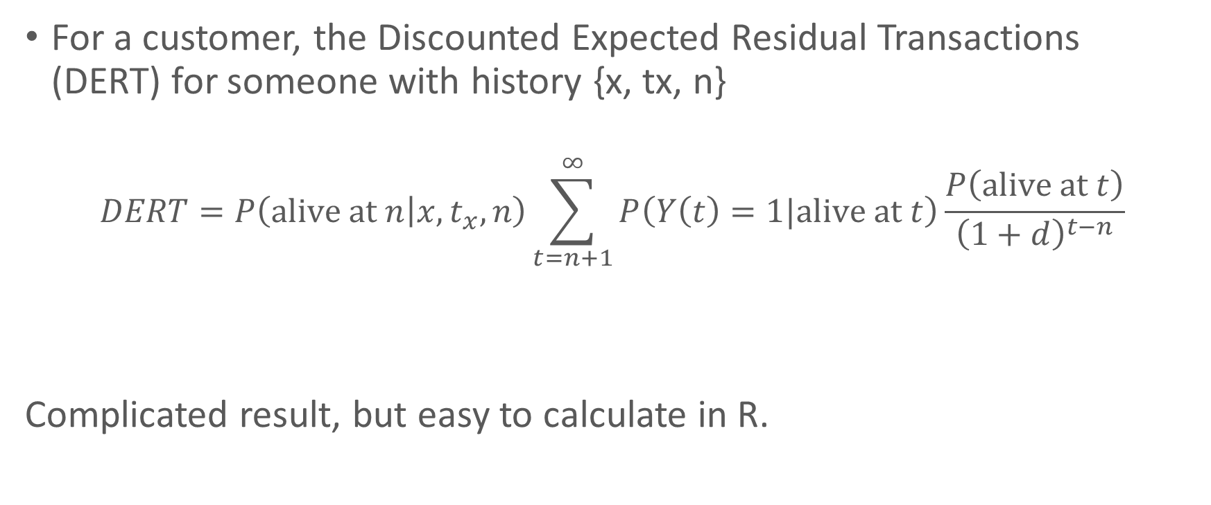
RLV
For a customer, the Discounted Expected Residual Transactions (DERT) for someone with history {x, tx, n}
$$DERT=P\left(\text{alive} \text{at} n | x,t_{x}, n\right)\sum_{t=n+1}^{∞}{P\left(Y\left(t\right)=1|\text{alive} \text{at} t\right)\frac{P\left(\text{alive} \text{at} t\right)}{{\left(1+d\right)}^{t−n}}}$$
Complicated result, but easy to calculate in R.
-> integrate expression over joint posterior distribution of $p$ and $θ$ (Eq. 14)
Fader, Hardie and Shang (2010), Customer-Base Analysis in a Discrete Time Noncontractual Setting

Slide 31
## x t.x n.cal custs RLV
## [1,] 6 6 6 1203 295.48
## [2,] 5 6 6 728 254.46
## [3,] 4 6 6 512 213.44
## [4,] 3 6 6 357 172.42
## [5,] 2 6 6 234 131.40
## [6,] 1 6 6 129 90.38
## [7,] 5 5 6 335 142.74
## [8,] 4 5 6 284 159.84
## [9,] 3 5 6 225 142.10
## [10,] 2 5 6 173 113.62
## [11,] 1 5 6 119 80.44
## [12,] 4 4 6 240 45.92
## [13,] 3 4 6 181 81.46
## [14,] 2 4 6 155 83.27
## [15,] 1 4 6 78 66.09
## [16,] 3 3 6 322 17.60
## [17,] 2 3 6 255 42.21
## [18,] 1 3 6 129 46.76
## [19,] 2 2 6 613 9.38
## [20,] 1 2 6 277 24.74
## [21,] 1 1 6 1091 6.75
## [22,] 0 0 6 3464 5.74
m=50, d=.1
Notes:
How much is a 6 for 6 customer worth?

Slide 32
Discrete to continuous time
Opportunities for transaction occur at discrete points in time
Concerts or conferences occur only one point in time
Firms think of it as discrete:
Did the customer place an order in response to a quarterly mailing or campaign?
Next page
Suppose we have a year of data from Amazon or Bol.
Should we define
12 monthly transaction opportunities
52 weekly
365 daily

Slide 33

In response to a specific campaign

Slide 34
Classifying customer bases
Basic idea same: a purchase process, a drop out process, heterogeneity
Grocery purchasing
Hotel stays
Prepaid cell phone
Credit cards
Utilities
Airmiles, loyalty programs
Continuous
Opportunities for Transactions
Charity fund drives
Concert/conference attendance
JUST NOW
Media subscription
Insurance policies
LAST LECTURE
Discrete
Non-contractual
Contractual
Type of business setting

Slide 35
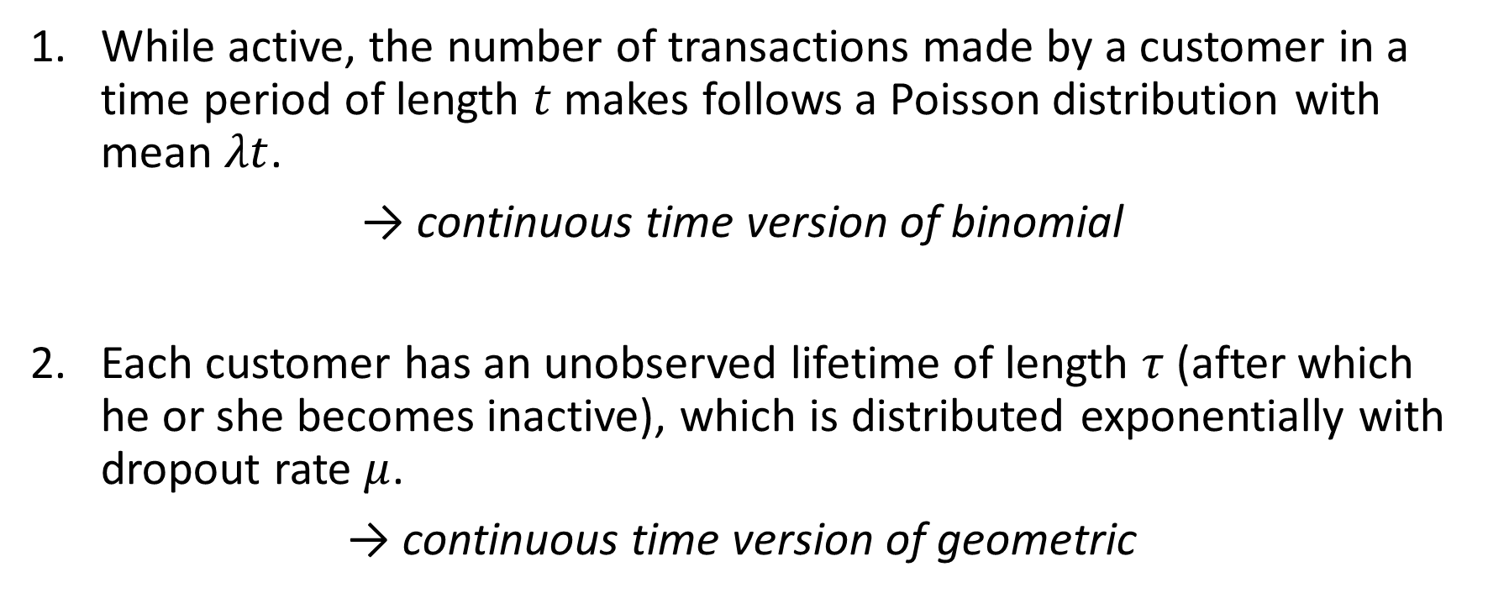
Pareto/NBD
While active, the number of transactions made by a customer in a time period of length $t$ makes follows a Poisson distribution with mean $λt$.
→ continuous time version of binomial
Each customer has an unobserved lifetime of length $τ$ (after which he or she becomes inactive), which is distributed exponentially with dropout rate $μ$.
→ continuous time version of geometric

Slide 36


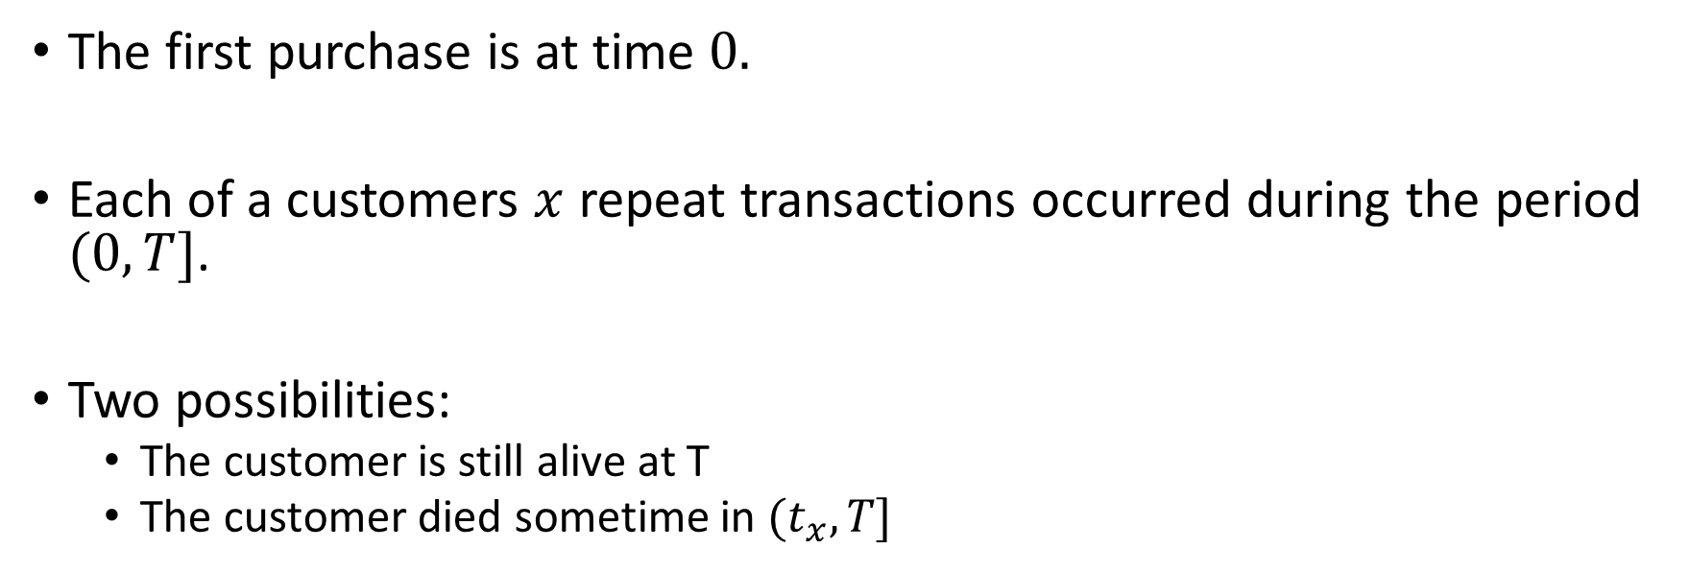



Pareto/NBD
$$0$$
$$t_{1}$$
$$t_{2}$$
$$t_{x}$$
$$T$$
X
X
…..
X
The first purchase is at time $0.$
Each of a customers $x$ repeat transactions occurred during the period $(0,T]$.
Two possibilities:
The customer is still alive at T
The customer died sometime in $(t_{x},T]$

Slide 37
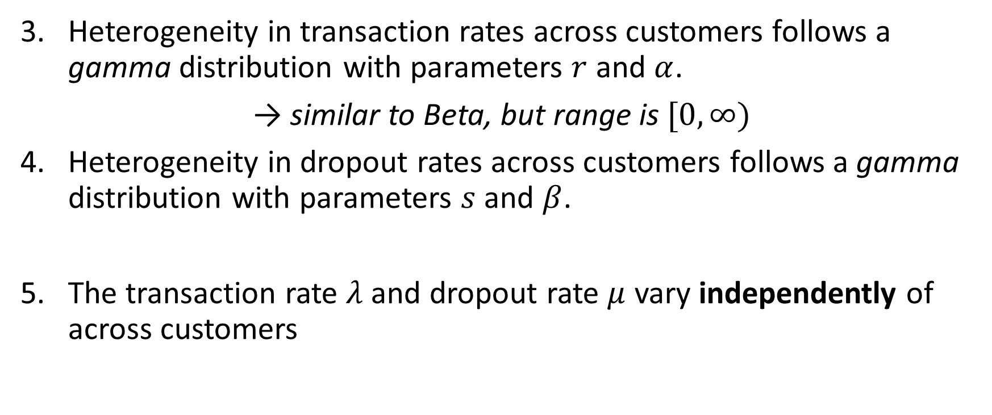
Pareto/NBD
Heterogeneity in transaction rates across customers follows a gamma distribution with parameters $r$ and $α$.
→ similar to Beta, but range is $[0, ∞)$
Heterogeneity in dropout rates across customers follows a gamma distribution with parameters $s$ and $β$.
The transaction rate $λ$ and dropout rate $μ$ vary independently of across customers

Slide 38

Sufficient statistics and related model
As with BG/BB model, the sufficient statistics of the model are the number of repeat purchases ($x$), the recency of the last purchase ($t_{x}$) and the end of the observation period ($T$).
x t.x T.cal
1 2 30.43 38.9
2 1 1.71 38.9
3 0 0.00 38.9
4 0 0.00 38.9
5 0 0.00 38.9
6 7 29.43 38.9

Slide 39
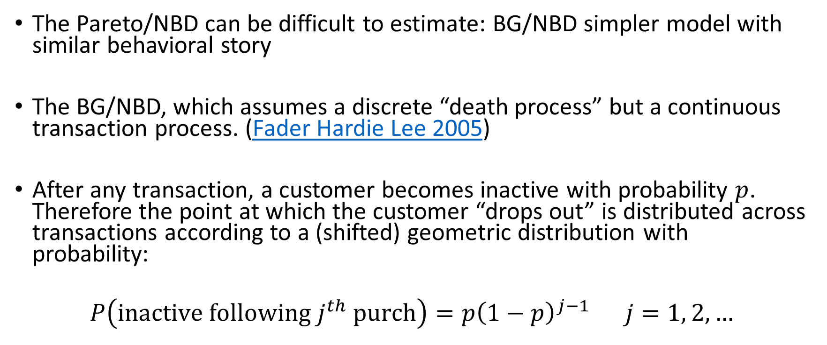
BG/NBD
The Pareto/NBD can be difficult to estimate: BG/NBD simpler model with similar behavioral story
The BG/NBD, which assumes a discrete “death process” but a continuous transaction process. (Fader Hardie Lee 2005)
After any transaction, a customer becomes inactive with probability $p$. Therefore the point at which the customer “drops out” is distributed across transactions according to a (shifted) geometric distribution with probability:
$$P\left(\text{inactive} \text{following} j^{th} \text{purch}\right)=p{\left(1−p\right)}^{j−1} j=1, 2, …$$
Notes:
Estimate in excel.

Slide 40
Latent attrition models
Dynamics
Customers go through two stages in their “lifetime” with a specific firm: they are alive for some period of time, then become permanently dead.
Heterogeneity
Customers differ in their transaction/purchase rates and in their death rates

Slide 41
Customer-base analysis
When you have a database of customers, generally you want to determine:
Which customers are most likely to be active in the future
The number of transactions to expect in the future for them, individually and collectively
CLV/RLV
Note these are predictive, not descriptive statistics

Slide 42
Advantages relative to RFM and other next-period models
With the next-period models we discussed in class, it’s hard to make predictions beyond the next period, so CLV calculation is tough.
How do you make predictions for the period after next, and so on.
RFM and similar models don’t really have a customer “story” or theory about them.
Different slices of the data yield different values

Slide 43
Extensions
Incorporating other characteristics, marketing activities, competition
Complaints and recoveries (Knox and van Oest 2014)
Service quality (Braun, Schweidel and Stein 2015)
Direct marketing (Schweidel and Knox 2013)
Notes on extensions from Bruce Hardie’s website
Contextual variables (Bachmann, Meierer & Näf 2021), check out their R package CLVTools
Have to be careful about sample selection (from e.g., targeting) and other issues
Need full datasets, no more sufficient statistics
Relaxing independence of distributions of purchasing and dropout
Extensions allowing for correlation (Abe 2008)
Requires simulation

